Slide 1
Buffer Overflows

Slide 2
BUFFER OVERFLOWS
One of the most common vulnerability found in a software.
Particularly problematic when present in system libraries and other code that runs with high execution privileges.
Still of major concern due to
legacy of widely deployed buggy
continued careless programming techniques

Slide 3
ABSTRACT

Slide 4
Buffer Overflow Basics
Caused due to careless programming.
Allows more data to be stored than capacity available in a fixed sized buffer.
Buffer can be on STACK,HEAP,GLOBAL DATA
Overwriting adjacent memory locations
corruption of program data
unexpected transfer of control
memory access violation
execution of code chosen by attacker

Slide 5
How it works
Application reserves adjacent memory locations (buffer) to store arguments to a function, or variable values.
Attacker gives an argument too long to fit in the buffer.
The application copies the whole argument, overflowing the buffer and overwriting memory space.
If the conditions are “just right” this will enable to attacker to gain control over the program flow and execute arbitrary code, with the same privileges of the original application.

Slide 6
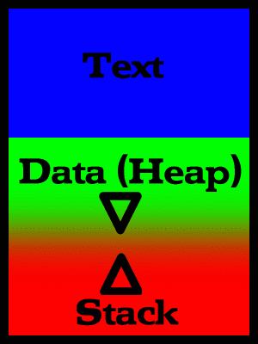
Stack Buffer Overflow Basics
Lower Memory Addresses
A process in memory:
- text (Program code;
marked read-only, so any attempts to write to it will result in segmentation fault).
- data segment (Global and
static variables)
- stack (Dynamic variables)
The process is blocked and is rescheduled to run again with a larger memory space if the user attack exhausts available memory.
High Memory Addresses

Slide 7
Stack smashing
<previous stack frame>
Function (sub-routine) calls results in an activation frame being pushed onto a memory area called the stack.
function arguments
return address
previous frame pointer
local variables
local buffer variables
Direction of Stack growth

Slide 8
The general idea is to overflow a buffer so that it overwrites the return address.
When the function is done it will jump to whatever address is on the stack.
We put some code in the buffer and set the return address to point to it!

Slide 9
Memory management
Stack
The stack, which contains activation frames, starts at the highest memory address allocated for the process, and grows downwards
Variable-length data (e.g., strings) that are read dynamically, are kept in the heap, which grows upwards
This arrangement maximizes flexibility of virtual memory management
Direction of stack growth
Direction of heap growth
Heap
unitialized variables
initialized variables
code instructions

Slide 10
Before and After
void foo(char *s) {
char buf[100];
strcpy(buf,s);
…
address of s
address of s
return-address
pointer to pgm
Small Program
saved sp
buf

Slide 11
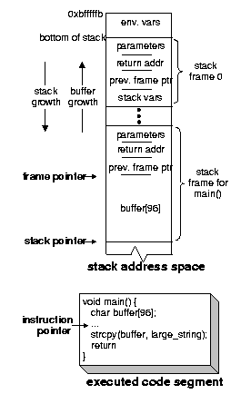
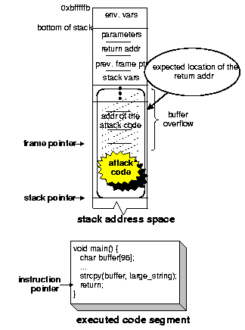
(i) Before the attack
(ii) After injecting the attack code

Slide 12
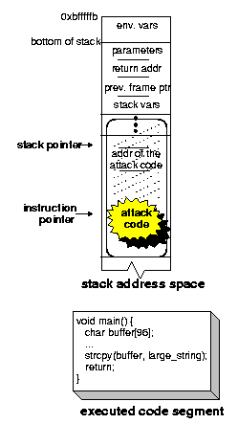
(iii) Executing the attack code

Slide 13
STACK OVERFLOW Example

Slide 14
OUTPUT

Slide 15
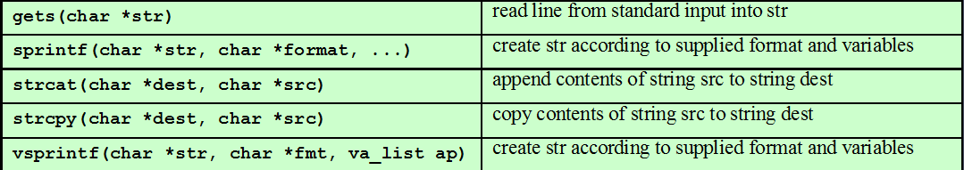
Common Unsafe C Functions

Slide 16
CASE STUDY

Slide 17
Buffer Overflow Defenses
Buffer overflows are widely exploited
Large amount of vulnerable code in use
despite cause and countermeasures known
Two broad defense approaches
compile-time - harden new programs
run-time - handle attacks on existing programs

Slide 18
Compile-Time Defenses
Safe Coding Techniques
If using potentially unsafe languages .
Eg :- C
Programmer must explicitly write safe code
by design with new code.
extensive after code review of existing code, (e.g., OpenBSD).
Buffer overflow safety a subset of general safe coding techniques .
Allow for graceful failure (know how things may go wrong) check for sufficient space in any buffer.

Slide 19
Language Extension, Safe Libraries
Proposals for safety extensions (library replacements) to C performance penalties
must compile programs with special compiler
Several safer standard library variants
1.) New functions, e.g. strlcpy()
2.)safer re-implementation of standard
functions as a dynamic library,
e.g. Libsafe

Slide 20
Stack Protection
Stackgaurd: add function entry and exit code to check
stack for signs of corruption
Use random canary
e.g. Stackguard, Win/GS, GCC
check for overwrite between local variables and saved frame pointer and return address
abort program if change found
issues: recompilation, debugger support
Or save/check safe copy of return address (in a safe, non-corruptible memory area), e.g. Stackshield, RAD

Slide 21
Run-Time Defenses
Non Executable Address Space
Many BO attacks copy machine code into buffer and xfer ctrl to it
Use virtual memory support to make some regions of memory non-executable (to avoid exec of attacker’s code)
e.g. stack, heap, global data
need h/w support in MMU
long existed on SPARC/Solaris systems
recent on x86 Linux/Unix/Windows systems
Issues: support for executable stack code

Slide 22
Guard Pages
Place guard pages between critical regions of memory (or between stack frames)
flagged in MMU (mem mgmt unit) as illegal addresses
any access aborts process
Can even place between stack frames and heap buffers
at execution time and space cost

Slide 23
Other Overflow Attacks
have a range of other attack variants
Stack overflow variants.
Heap overflow
Global data overflow
Format string overflow
Integer overflow
more likely to be discovered in future
some cannot be prevented except by coding to prevent originally

Slide 24
CONCLUSION

